Slide 1
Introduction to Web Development
Terry & Darren

Slide 2
Agenda
Internet
HTML/CSS/JavaScript
Hacking Google
Tools
Visual Studio Code
GitHub

Slide 3
How the Internet works

Slide 4
The Internet is Numbers
Hello World
H -> 01001000
e -> 01100101
…
01001000 01100101 01101100 01101100 01101111 00100000 01010111 01101111 01110010 01101100 01100100

Slide 5
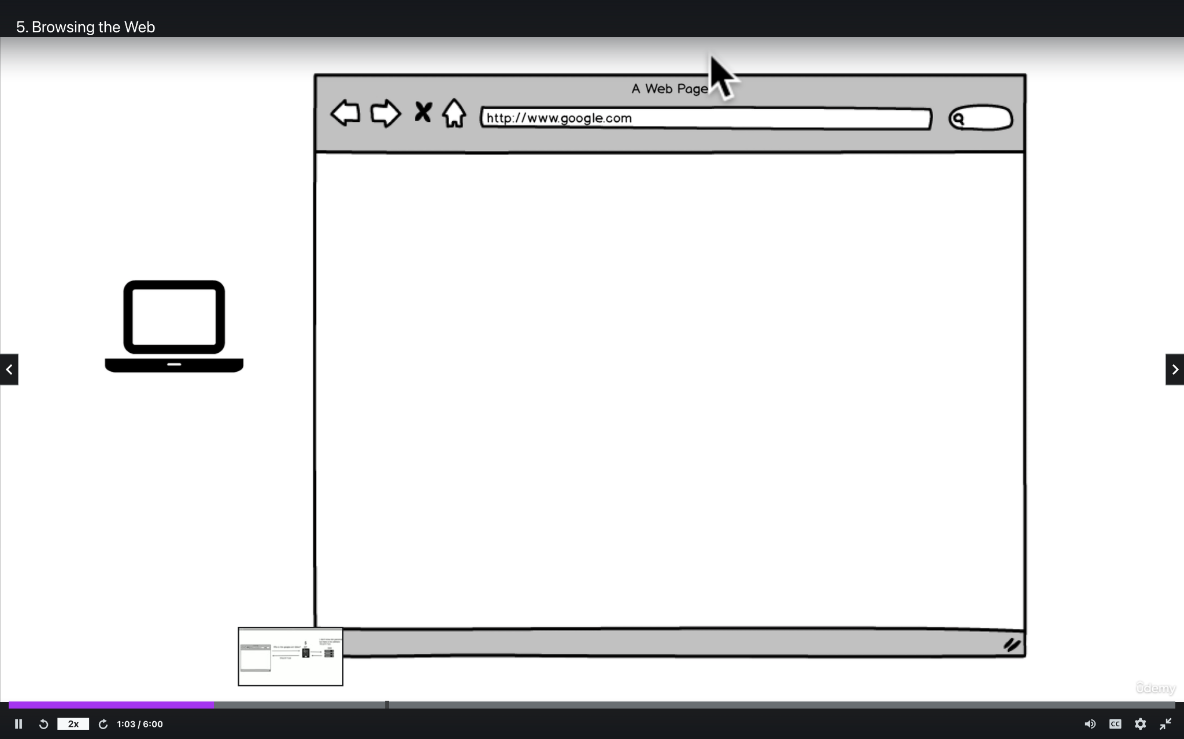

Slide 6
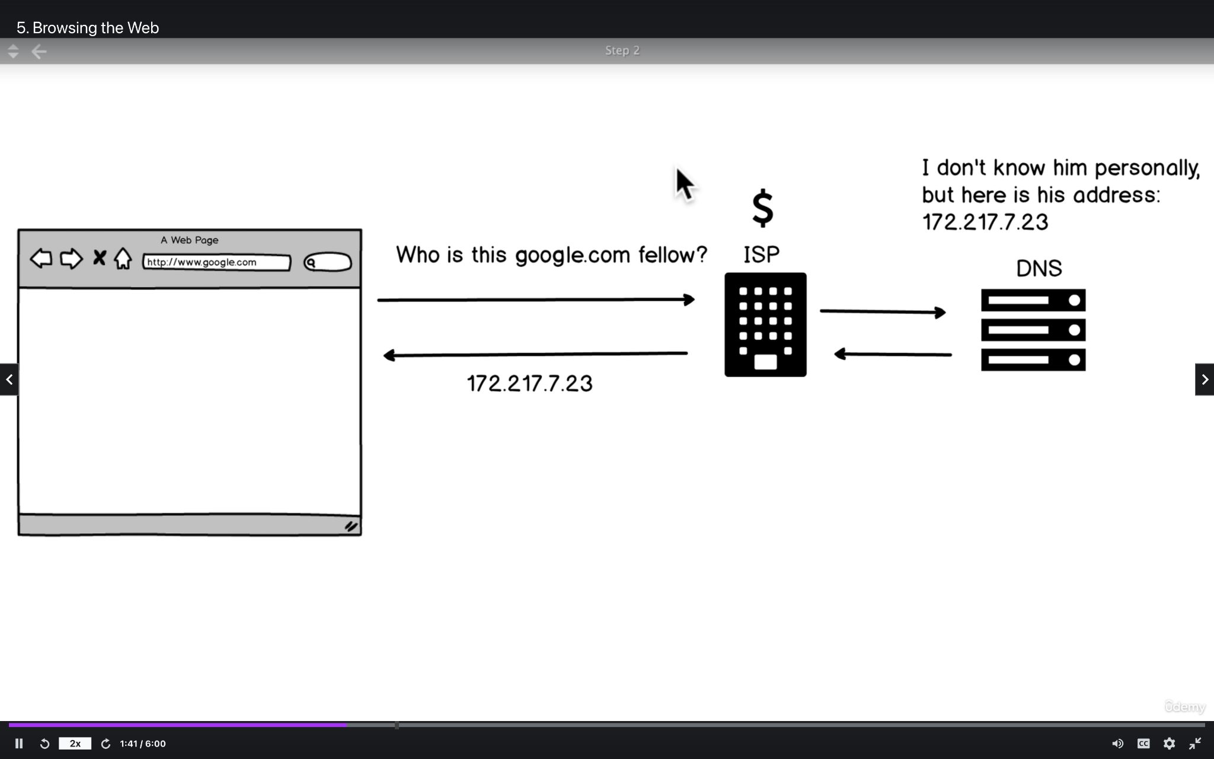
172.217.14.206
I don’t know him personally, but here is his address; 172.217.14.206
Notes:
ISP: Internet Service Provider
DNS: Domain Name Service

Slide 7
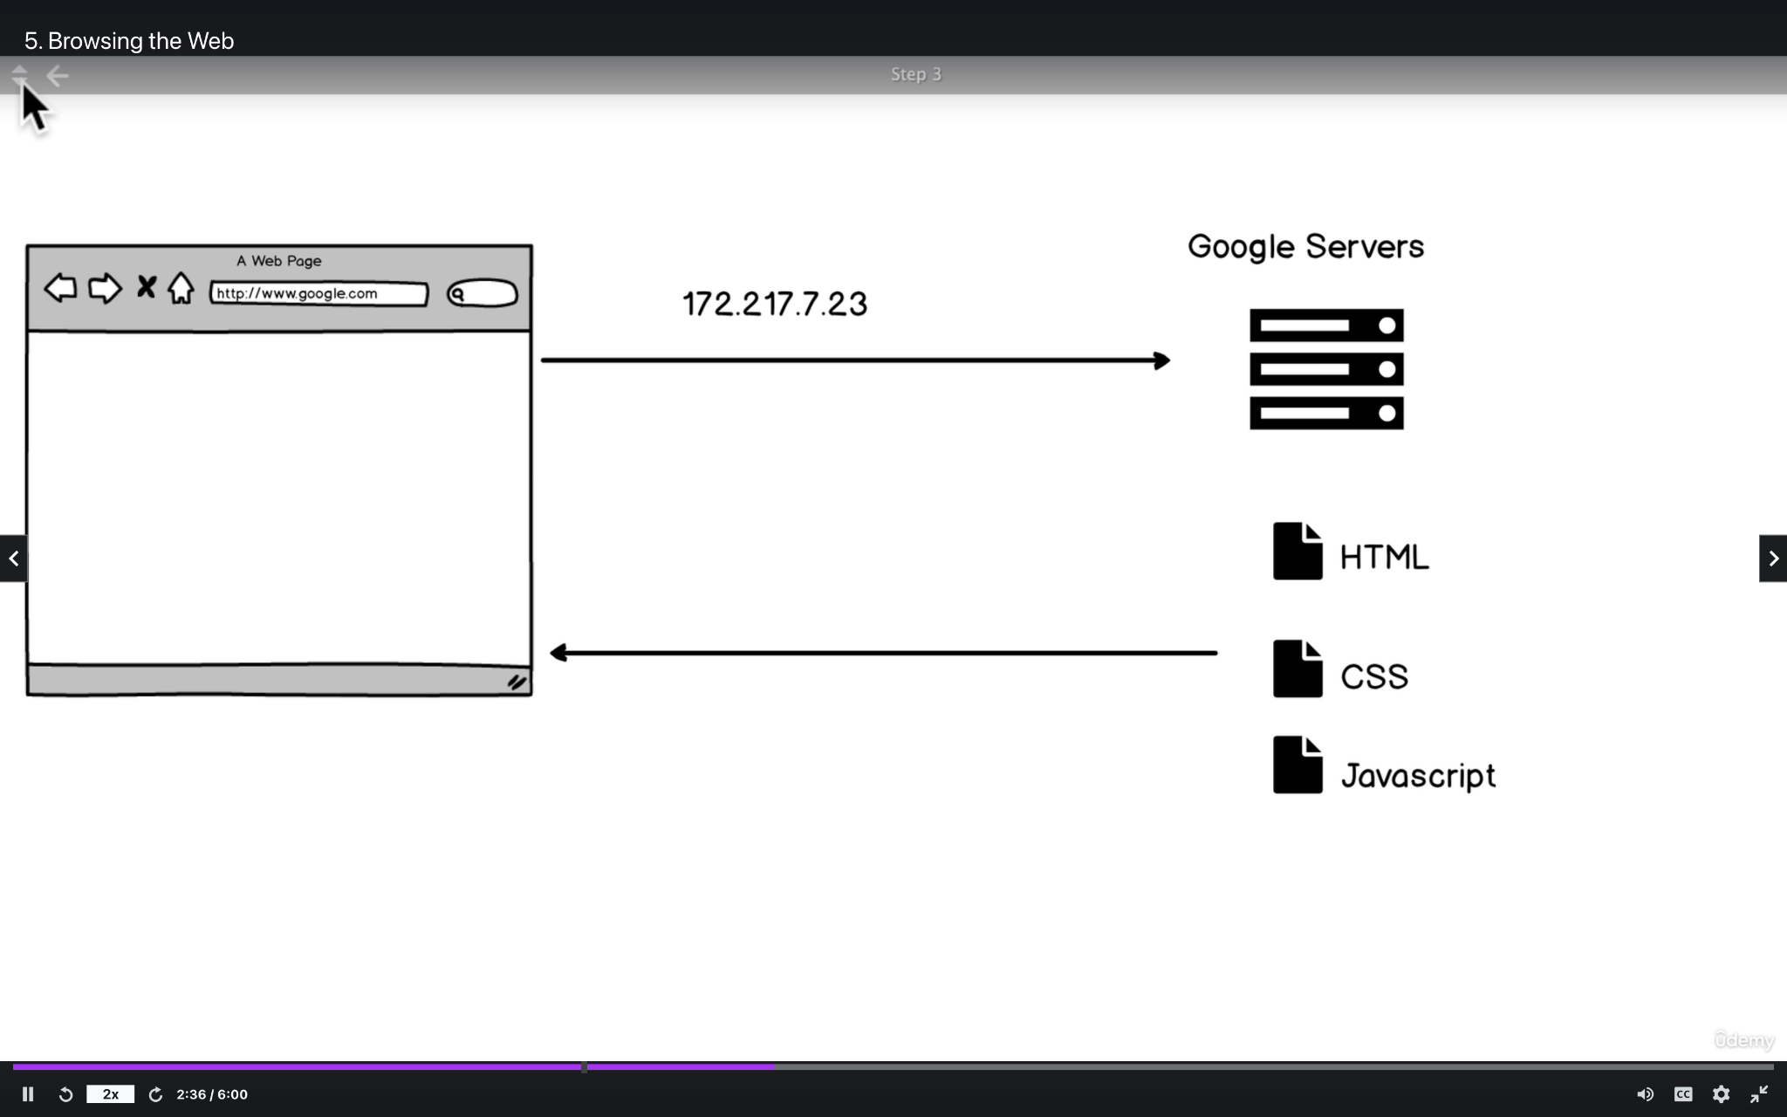
172.217.14.206

Slide 8
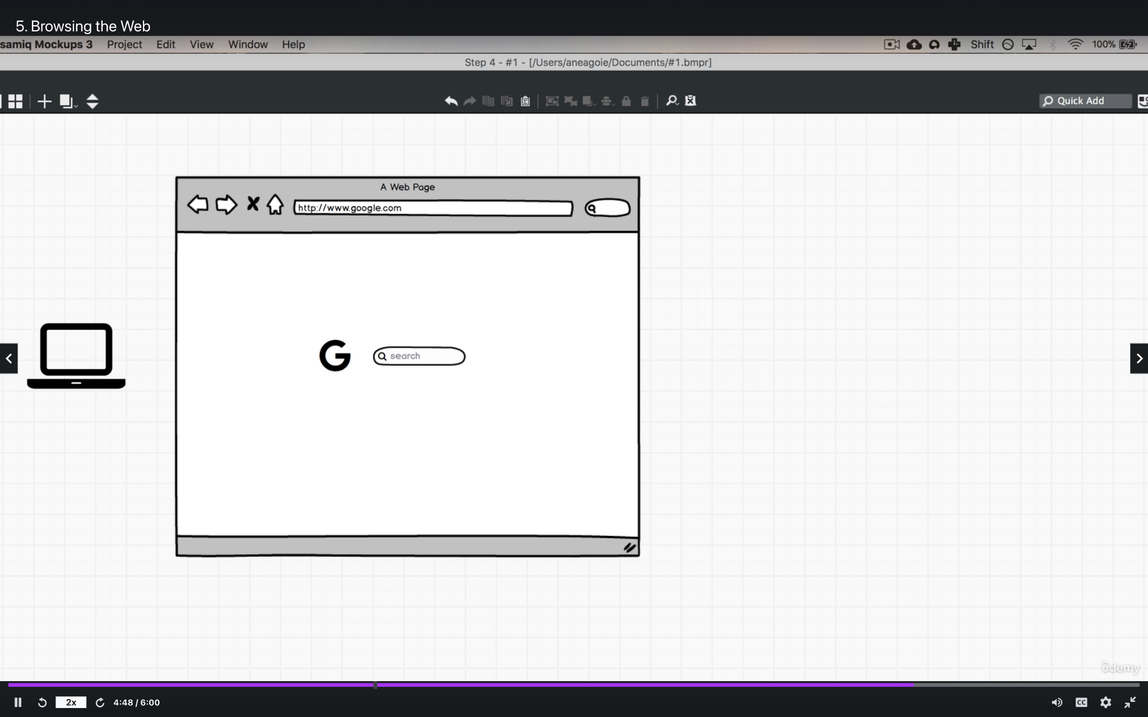

Slide 9
HTML/CSS/JavaScript
Website vs. Human Body

Slide 10
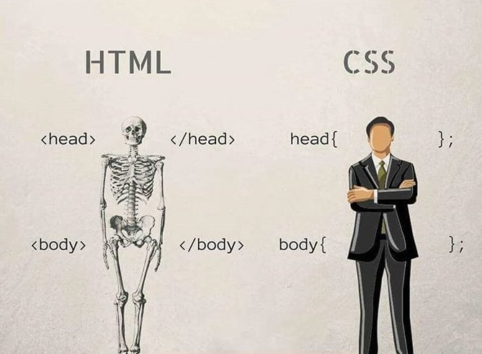
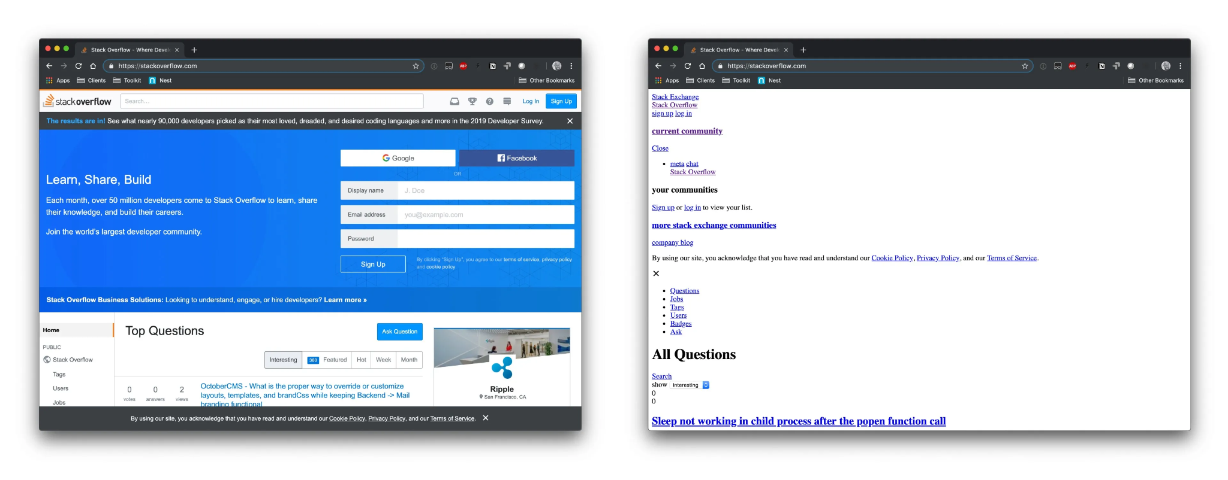
HTML (HyperText Markup Language) - Skeleton

Slide 11
CSS (Cascading Style Sheets) - Skin + Clothes

Slide 12
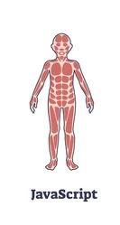

JavaScript - Muscle

Slide 13
Hacking Google

Slide 14
Hacking Time
Go to google.com
Right click and click “Inspect”
HACK!!
Question: What happens when you refresh the page?

Slide 15
Tool #1: Visual Studio Code

Slide 16


Microsoft Word But Better
Text editor with coding autocomplete
File organization/structure
Search for files quickly
Easy tabbing

Slide 17
Tool #2: GitHub

Slide 18

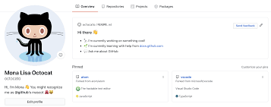
Social Media for Code
Displaying code and projects to public
Storing and saving code
Collaborating with a team
Used as resume

Slide 19
Reference
HTML Documentation:
https://www.w3schools.com/TAGS/default.ASP
CSS Documentation:
https://www.w3schools.com/cssref/
JavaScript Documentation:
https://www.w3schools.com/JSREF/DEFAULT.ASP
GitHub Documentation:
https://docs.github.com/en

Slide 20
Time to CODE!!!

Slide 21
Works Cited
https://www.udemy.com/course/the-complete-web-developer-zero-to-mastery/learn/lecture/8574414?start=90#overview
https://www.google.com/url?sa=i&url=https%3A%2F%2Fm.facebook.com%2F221076356050629&psig=AOvVaw0zVeIeYtxmxYFgpX0AG8SD&ust=1637486107765000&source=images&cd=vfe&ved=0CAsQjRxqFwoTCKjU1KLNpvQCFQAAAAAdAAAAABAJ
https://www.google.com/imgres?imgurl=https%3A%2F%2Fi0.wp.com%2Fcss-tricks.com%2Fwp-content%2Fuploads%2F2019%2F04%2Fs_601945040BCA3610D759145A4442799C97B904D9A9F8326DD30FDF0CF48A96B7_1555362067943_stackoverflow-compare.jpg%3Fssl%3D1&imgrefurl=https%3A%2F%2Fcss-tricks.com%2Fthat-time-i-tried-browsing-the-web-without-css%2F&tbnid=Poq1oviYBuN0UM&vet=12ahUKEwj2qK3Hzab0AhW_sHIEHb5LA0MQMygDegUIARC2AQ..i&docid=B0Pa59QYPiw2kM&w=3840&h=1503&itg=1&q=html%20without%20css&ved=2ahUKEwj2qK3Hzab0AhW_sHIEHb5LA0MQMygDegUIARC2AQ
https://www.google.com/url?sa=i&url=https%3A%2F%2Fwww.shutterstock.com%2Fsearch%2Fhuman%2Bmuscles%2Blabeled&psig=AOvVaw2xGNNceNqcptTDGDyFIu2F&ust=1637486226133000&source=images&cd=vfe&ved=0CAsQjRxqFwoTCIjZmtvNpvQCFQAAAAAdAAAAABAD
https://www.google.com/url?sa=i&url=https%3A%2F%2Ffusionauth.io%2Flearn%2Fexpert-advice%2Fauthentication%2Flogin-authentication-workflows%2F&psig=AOvVaw06wqdglhFOxkh1BCYKU-CY&ust=1637486441813000&source=images&cd=vfe&ved=0CAsQjRxqFwoTCIiL88POpvQCFQAAAAAdAAAAABAQ

